Slide 1






CA Business Ramp Up Plan
Jan 10th 2022

Slide 2
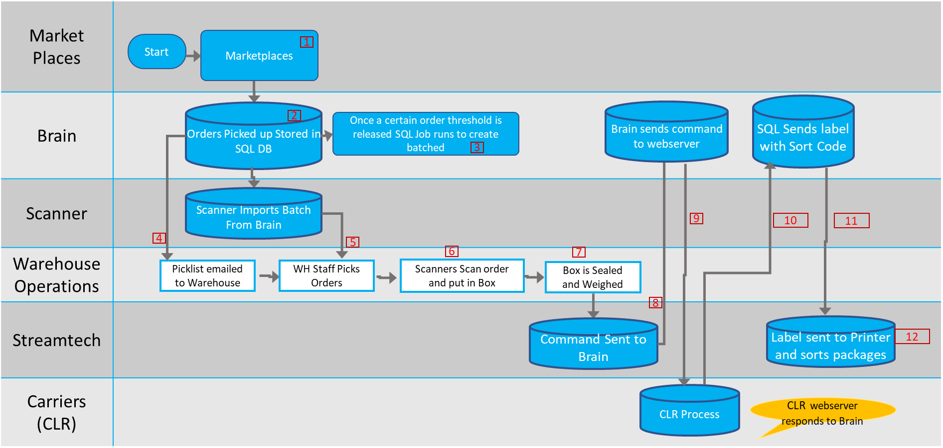
Packable As-Is – East Coast Outbound Process

Slide 3
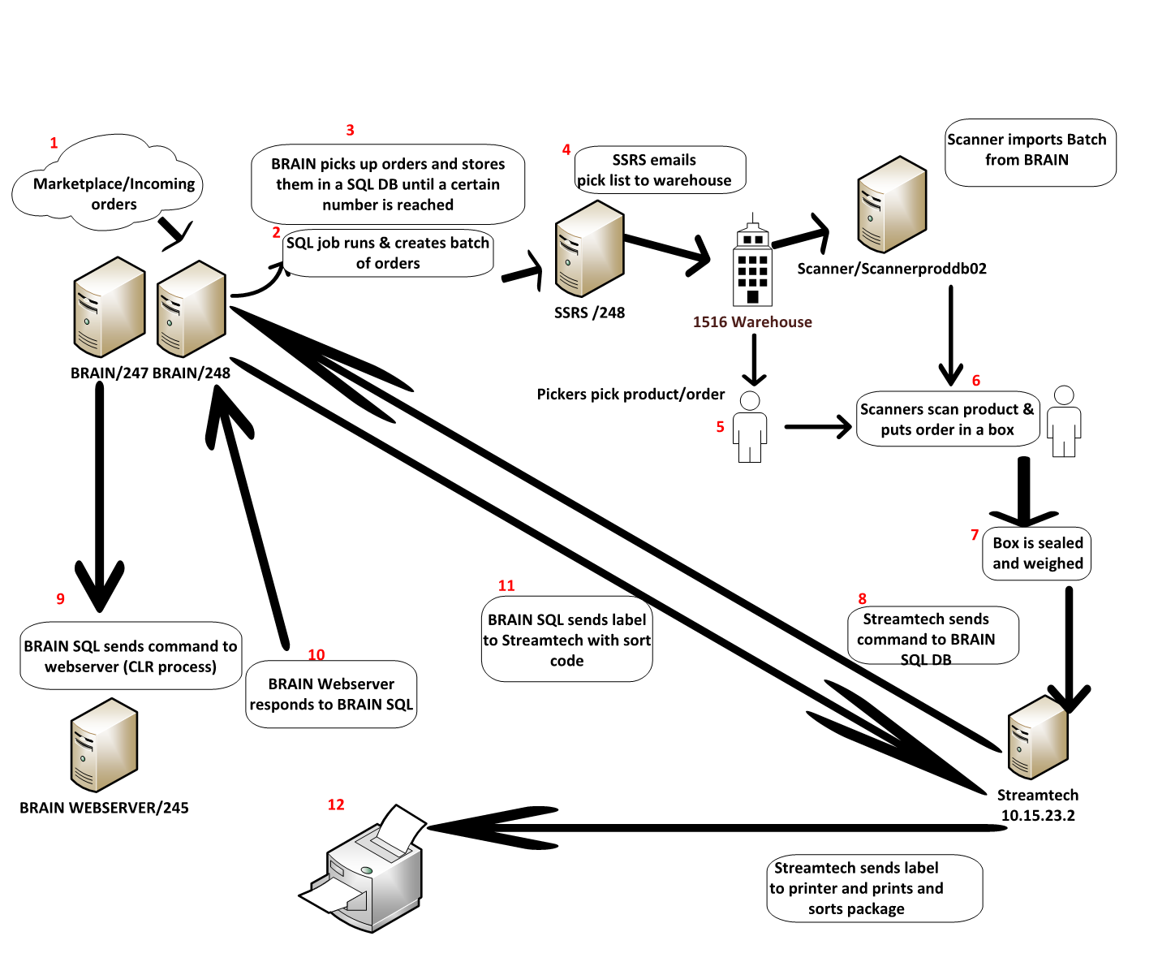

Slide 4
Market Places
Brain
Scanner
Warehouse Operations
Streamtech
Carriers (CLR)
Brain decides which DC based on Inventory / Profitability / Staffing
Estimated shipping DB’s will be utilized to determine Lease cost shipping
Start
Marketplaces
Shipping information sent to market places via batches by Brain
End
1
13
Orders Picked up Stored in SQL DB
Brain sends command to webserver
Brain Sends label with Sort Code
2
Once a certain order threshold is released SQL Job runs to create batched
3
There will be 2 instances of Scanner (East Coast / West Coast)
Scanner Imports Batch From Brain
9
10
11
4
5
6
7
Picklist emailed to Warehouse
WH Staff Picks Orders
Scanners Scan order and put in Box
Box is Sealed and Weighed
8
Command Sent to Brain
Label sent to Printer and sorts packages
12
CLR Process
CLR webserver responds to Brain
Shipping Manifest created

Slide 5
New Functionality for Brain to dispatch order to CA or NY
Business requirements by Categories | Additional comments / Follow-ups
Assumptions for CA ramp-up and stabilization in 2022 NO change to NY operation driven by systems changes CA to deliver 27% Sellers Fulfillment in 2022 Assumption of steady state no of orders in CA as 15,000 / day post people/systems readiness or the stabilization (July onwards) Initial 7000 SKUs in CA for initial start-up ramping up to 10K dependent on product availability and CA labor capacity | Validated no of SKUs with Paul S The 2022 budget validated with Finance (Chris Cherwa)
Core rules for Order Fulfillment by CA (Default fulfilment by NY region) CA authorized Items list Inventory availability at CA Shipment cost (Profitability) compared to NY CA Workload queue. Up to a certain number of orders by 1-Prime, 2- Multi line 3- Heavies 4-Std Single line. Operation needs flexibility to configure this rule in Brain through Screen/UI interface Additional rules No Order buffering by Brain – Instant dispatch decision to CA or NY subject to core rules No ability to transfer the Order/s from CA to NY or vice-versa as normal course of business to reduce systems complexity Orders fulfillment will NOT be split across 2 regions (100% order fulfilled by a single region) Continue to do Order split logic of Multi-line orders (for deliveries) for CA NO CA-only Prime template prior to July 2022 (due to potential conflict with core-rule 4). | Open / Follow-ups for Day 1 or Future What will be the Reporting for Day-1 to track the daily Order Split by NY and CA (See Reporting section)
Define 3 Marketplace templates for Brain (applicable for July-2022 onwards) | Pending requirements and solution approach
Systems architecture guidelines Brain will do initial Order orchestration driven by Market place templates Scanner and WMS will remain regional Order Fulfillment systems (Unique Production instances for NY and CA regions)
Notes:
CA-only template = Items exclusively in CA for Prime orders

Slide 6
New Functionality for Brain to dispatch order to CA or NY
Business requirements | Actions / Follow-ups
Schedule for Order Batching from Brain to Scanner-> WMS No change to Order batching schedule for NY Order batching for CA should consider the size of the work-queue in CA (as set by Operation-Rule#3). 2 options for CA Order batching schedule: Follow NY schedule to reduce Brain design change complexity Follow NY Phase-2 design as follows: NY Phase 2 Brain was batching every 30 minutes and Scanner sending WMS every 10 minutes WMS will Auto-Wave based on Scanner batch | Current NY Batch schedule in ET 4AM Batch all orders available 8AM – DTC Batch 11:30AM - Prme Only Batch – Will batch orders to ship before EOD 2PM – Catch All batch – 3PM – Everything possible that needs to ship today
De-risk NY operation with CA systems changes in Brain, Scanner and WMS Systems development and unit testing in Brain & Scanner to be completed before Feb 14th to follow CA WMS project plan Other ideas? | Pending alignment
Reporting for Day 1 Scope: Brain Scanner Engage Randy for the report development out of Brain | Pending requirements What will be the Reporting for Day-1 to track the daily Order Split by NY and CA (See Reporting section) Do we need consolidated view of existing Scanner reporting or define new consolidated reporting in Scanner WMS Dashboards / reporting requirement is governed / in-flight with CA WMS project
Scanner Hot-Pick orders Align on criteria with operations and maximize the automation without Guang’s manual intervention during Go-live/hypercare.

Slide 7
Post 2022 stabilization – Potential improvement ideas
Business requirements | Actions / Follow-ups
Order Transfer between CA and NY | Pending requirements to define the business and IT conditions for Order routing How to detect the conditions to transfer the orders? Who will own the decision to transfer the orders? Systematic solution to trigger the transferfor Day-1 and for stabilization If Order re-route is handled by Scanner, It is assumed that Brain do not need to be informed.

